Slide 1
Cyber Security-Attack Life Cycle
Dr. Bhawana Rudra
NITK

Slide 2
Disclaimer: The images and Information has been used from various resources of the web.

Slide 3
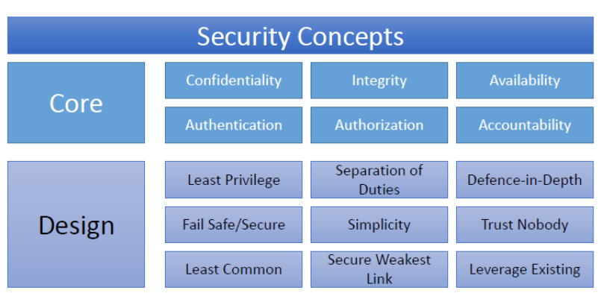
Network Security Principles

Slide 4
TYPES OF CYBER CRIME
HACKING :- Hacking in simple terms means an illegal intrusion info a computer system and/or network . It is also known as CRACKING. Government websites are the hot target of the hackers due to the press coverage, it receives.
Hackers enjoy the media coverage. Motive behind the crime called HACKERS Motive behind the crime called hacking greed power, publicity, revenge, adventure desire to access forbidden information destructive mindset wants to sell n/w security services.

Slide 5
CHILD PORNOGRAPHY : The Internet is being highly used by its abusers to reach and abuse children sexually, worldwide. As more homes have access to internet, more children would be using the internet and more are the chances of falling victim to the aggression of Pedophiles.
How Do They Operate :
How do they operate Pedophiles use false identity to trap the children , Pedophiles connect children in various chat rooms which are used by children to interact with other children

Slide 6
DENIAL OF SERVICE ATTACKS : This is an act by the criminals who floods the bandwidth of the victims network or fills his E-mail box with spam mail depriving him of the service he is entitled to access or provide. Many DOS attacks, such as the ping of death and Tear drop attacks.
VIRUS DISSMINITION : Malicious software that attaches itself to other software. VIRUS , WORMS, TROJAN HORSE ,WEB JACKING, E-MAIL BOMBING etc.
COMPUTER VANDALISM : Damaging or destroying data rather than stealing or misusing them is called cyber vandalism. These are program that attach themselves to a file and then circulate.

Slide 7
CYBER TERRORISM : Terrorist attacks on the Internet is by distributed denial of service attacks, hate websites and hate E-mails , attacks on service network etc.
SOFTWARE PIRACY : Theft of software through the illegal copying of genuine programs or the counterfeiting and distribution of products intended to pass for the original.

Slide 8
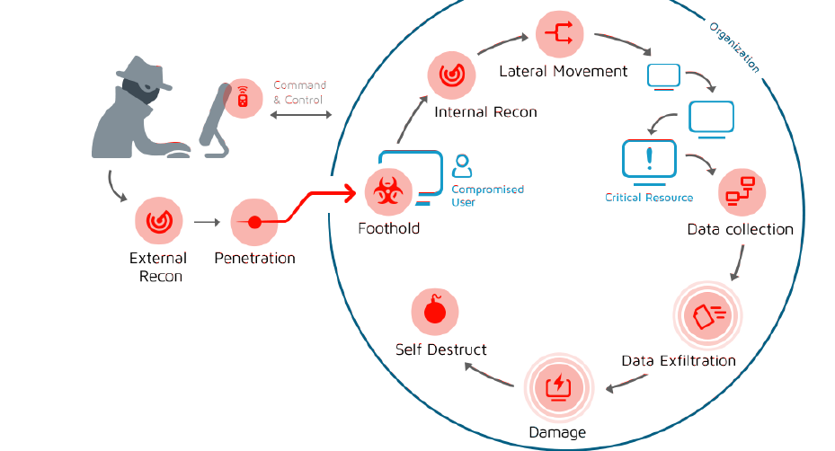
Attack Life-Cycle

Slide 9
External Recon
Social Networking
Conferences
Call Help Desk or Admin
External Scans
Buy Information/Tools in Black Market

Slide 10
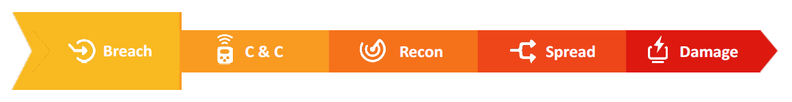
Breach: Penetration. Privilege escalation. Obfuscation.
Phishing & spear phishing
Vulnerability exploit
Social Engineering
Infected USB drive
Compromised credentials
Autorun
Process Injection

Slide 11
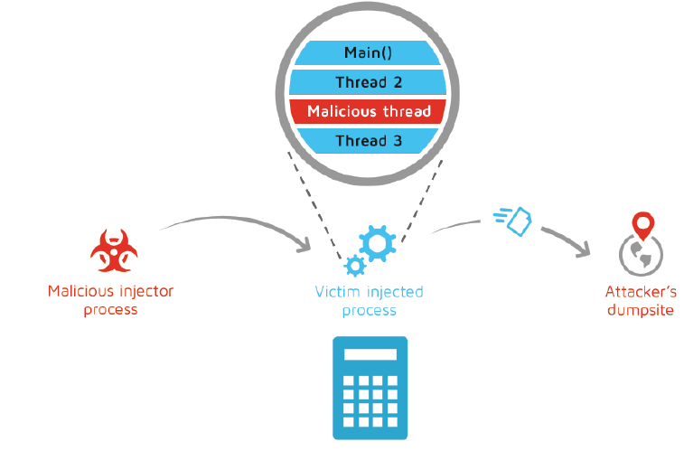
Process Injection
Running another procedure as a thread inside another process
Evasion
Reading host process memory
Affecting host process behavior

Slide 12

Command & Control
Operation. Exfiltration.
Legitimate HTTP
Legitimate DNS request
Fust Flux
TOR
Facebook / Twitter / YouTube comments
Domain Generation Algorithm

Slide 13
Command & Control
Domain generation algorithm
Regular C&C servers can be blacklisted and firewalled
DGA is generating a daily domain list (1000’s of domains)
Malware tries to resolve each one of those random domains.
The attack (who created the algorithm) knows which domains will be generated.
Once a certain C&C domain is blocked, attacker can select one of the daily generated domains, register it and continue his endeavors.

Slide 14
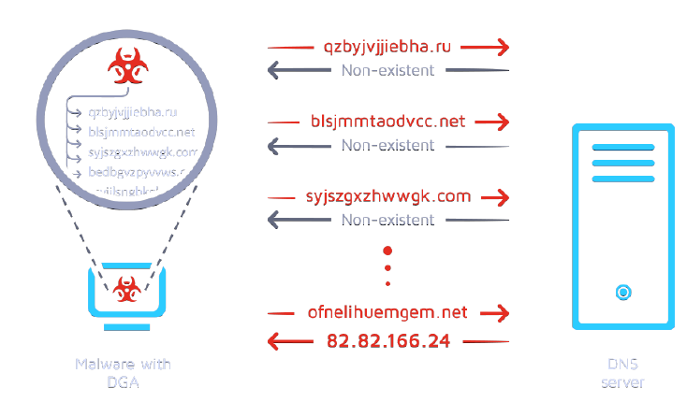
DGA

Slide 15
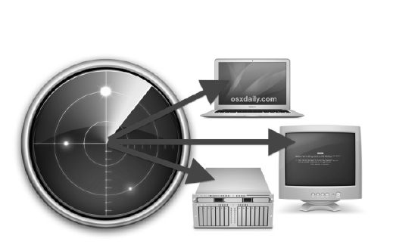

Recon Scanning
ARP scanning
SYN scanning – ("half-open scanning“)
FYN scanning
Port scanning

Slide 16
Reconnaissance
Port Scanning
Services are using ports to communicate (HTTP = 80, DNS = 53, etc.)
When an attacker gets a foothold on a computer, he needs to move around the organization.
The attacker scans the subnet to find exposed and exploitable services on other computers and platforms.
Once an open port is found, further exploitation occurs.

Slide 17
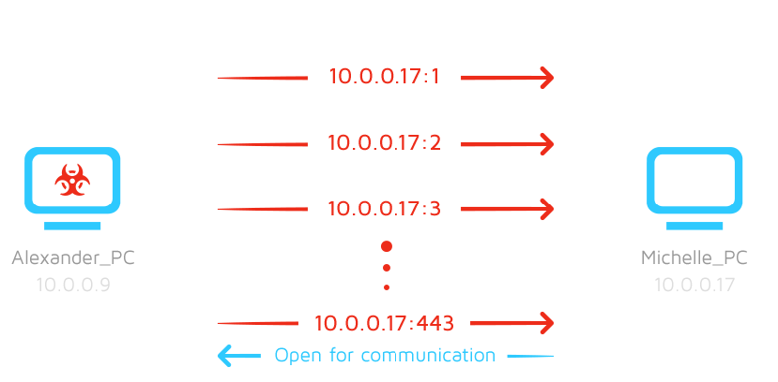

Slide 18

Spread
Lateral movement - Legitimate tools used maliciously
Pass The Hash/Ticket
Shares
PSExec

Slide 19
Spread
PSEXEC - Legitimate tools used maliciously
A legitimate tool by Microsoft.
Commonly used by IT professionals
Allows to run a process on a remote machine interactively.
Attackers use that technique to spread their malware through an entire network.

Slide 20
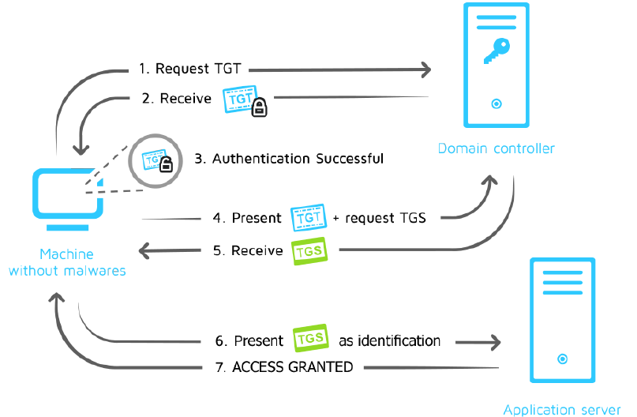
Lateral Movement

Slide 21
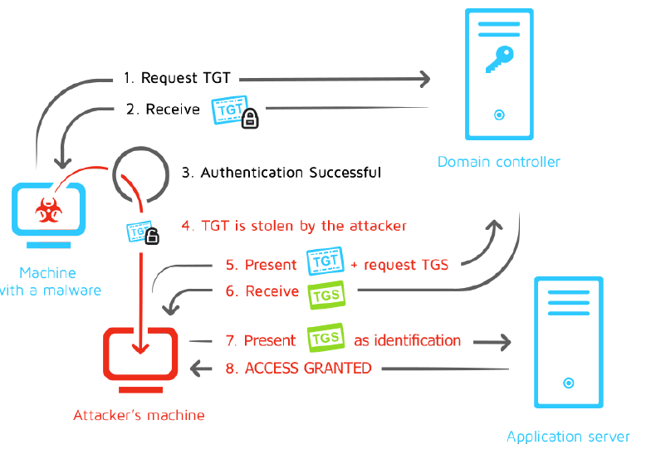

Slide 22
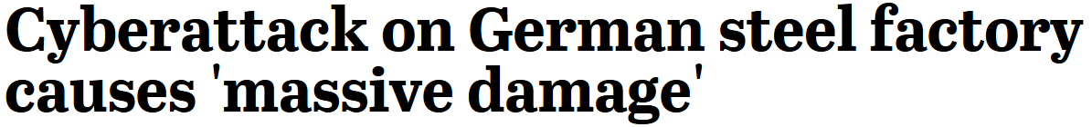

Damage. Business. Money. Physical

